Slide 1

Web App Development
COMP-229
Fall 2023

Slide 2
Web Technology Stacks and Supporting JavaScript Features
Objectives:
Compare MEAN and MERN full stack architecture
Explore the advancements in JavaScript.
Use Module pattern
Examine Event-Driven Model
Apply ES6+ Features

Slide 3
Full-Stack JavaScript
In 2008, Google released its Chrome browser, along with its fast JIT-compiling V8 JavaScript engine.
Google's V8 engine made JavaScript run so much faster that it completely transformed web application development.
One of the first products of this revolution was Node.js.
a V8-based database called MongoDB.
A frontend open source framework called AngularJS.
A frontend library called React.
Now JavaScript is the programming language across all three layers - an idea that is commonly referred to as the full-stack JavaScript.
The following stacks are examples of this idea:
The MEAN (MongoDB, Express, Angular, Node) stack
The MERN (MongoDB, Express, React, Node) stack

Slide 4

Programming, Scripting, Markup
https://insights.stackoverflow.com/survey/2021#most-popular-technologies-language-prof

Slide 5
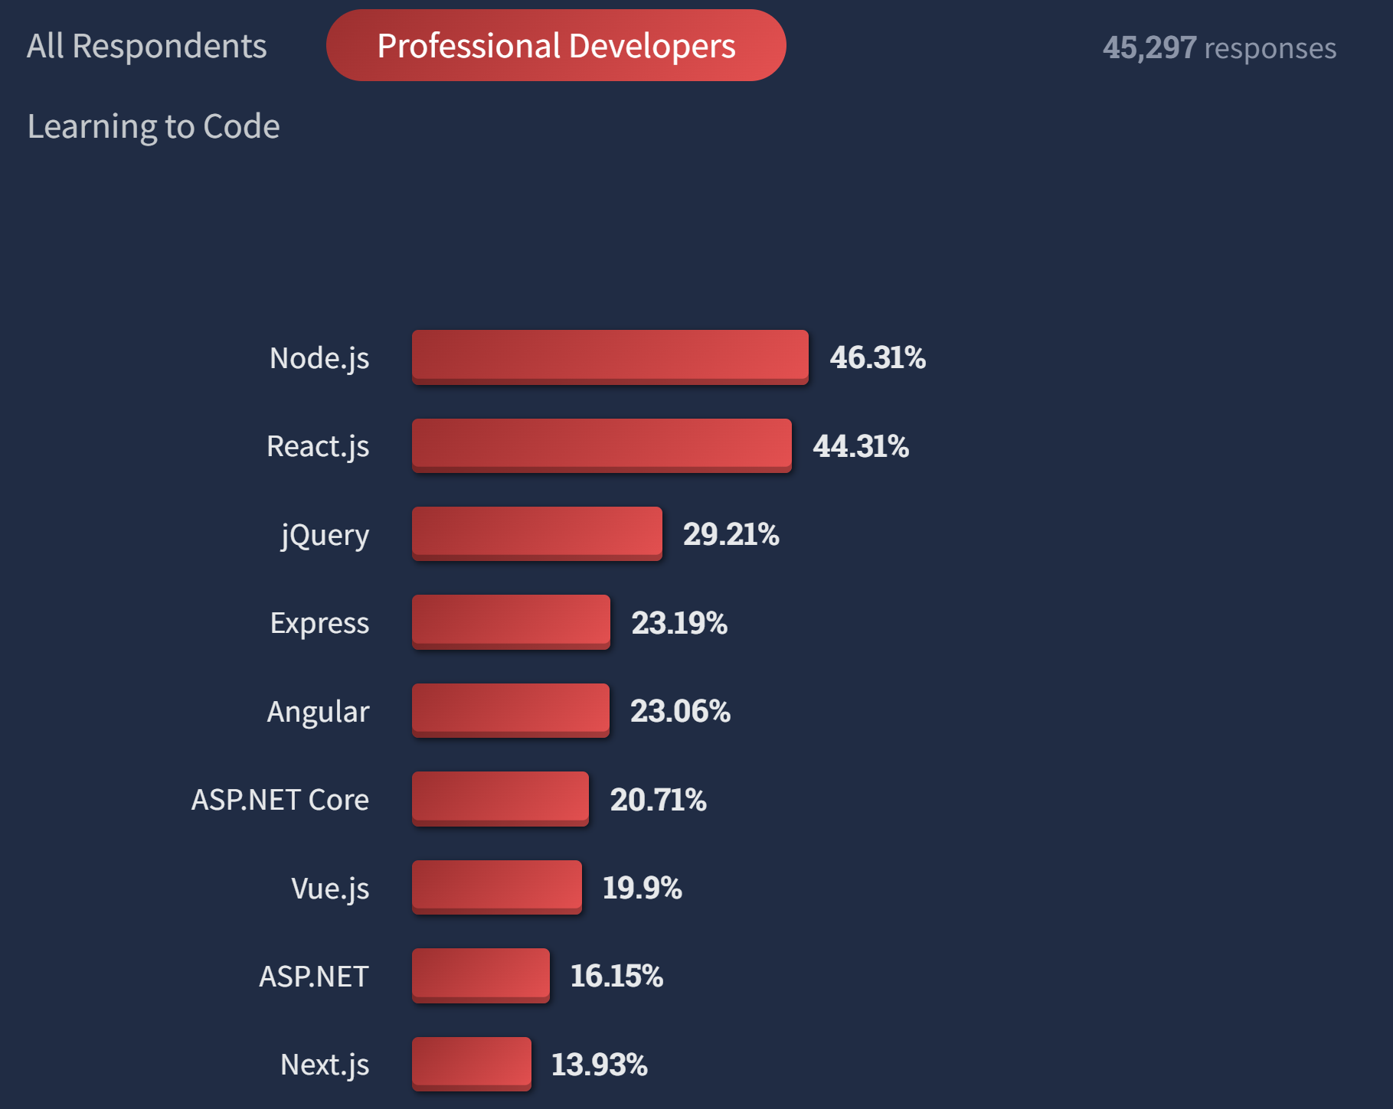
Web Frameworks/Libraries
https://survey.stackoverflow.co/2022/#most-popular-technologies-webframe-prof

Slide 6
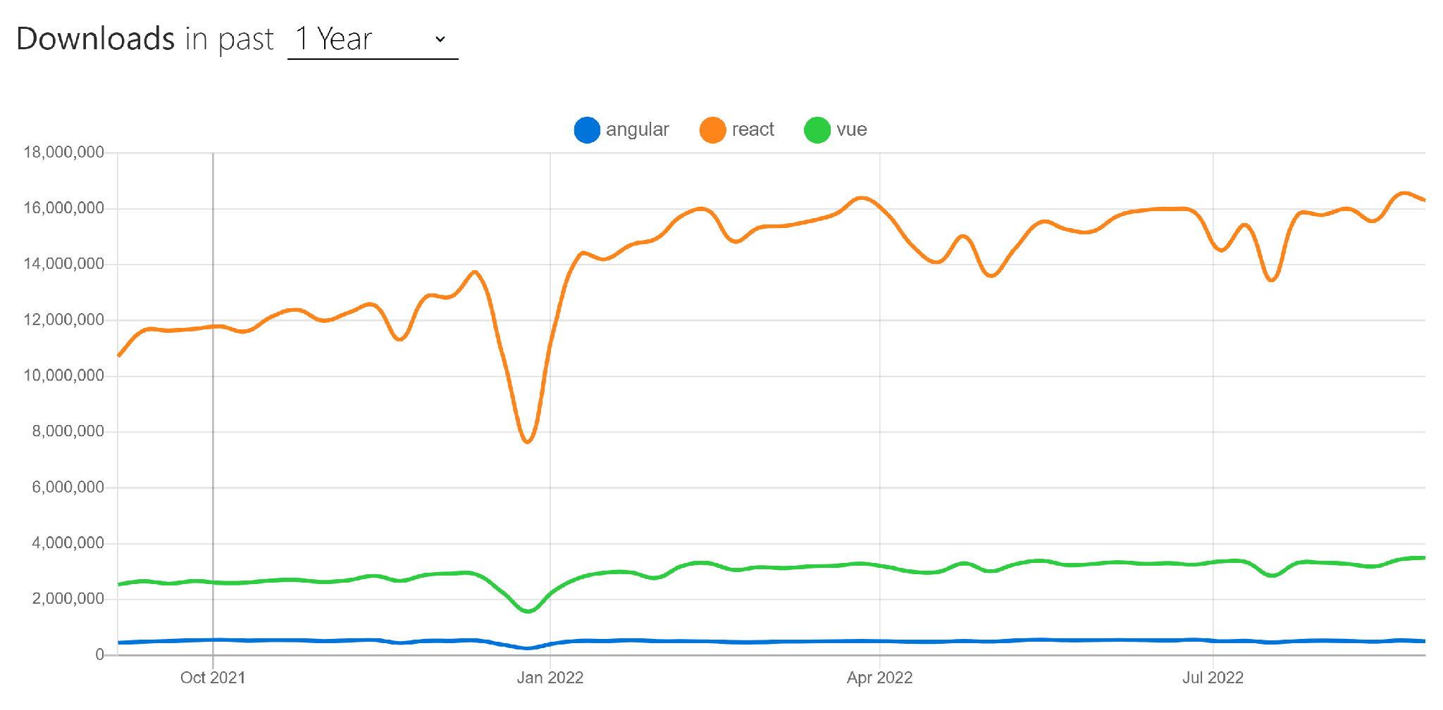
Front-End Frameworks/Libraries
https://www.npmtrends.com/angular-vs-react-vs-vue

Slide 7
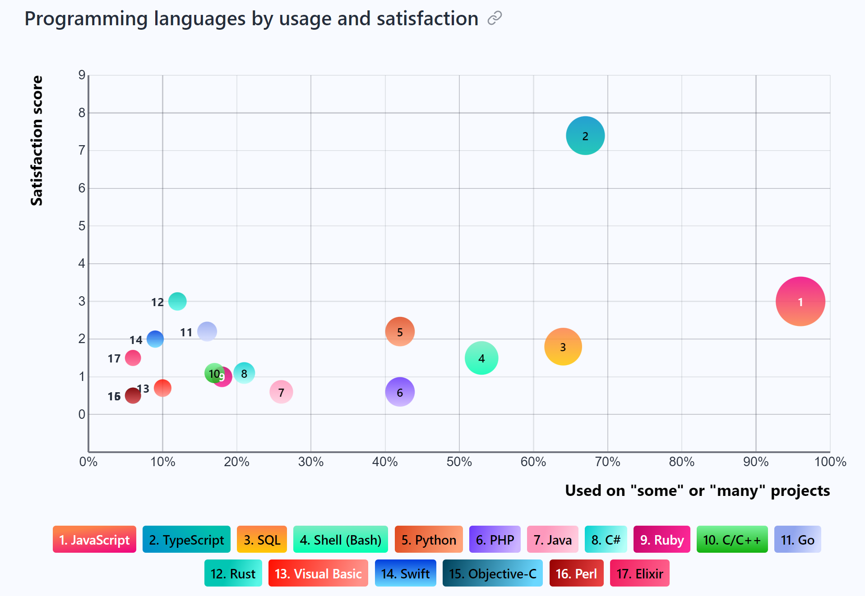
Jamstack Community Survey 2022
https://jamstack.org/survey/2022/#choices

Slide 8
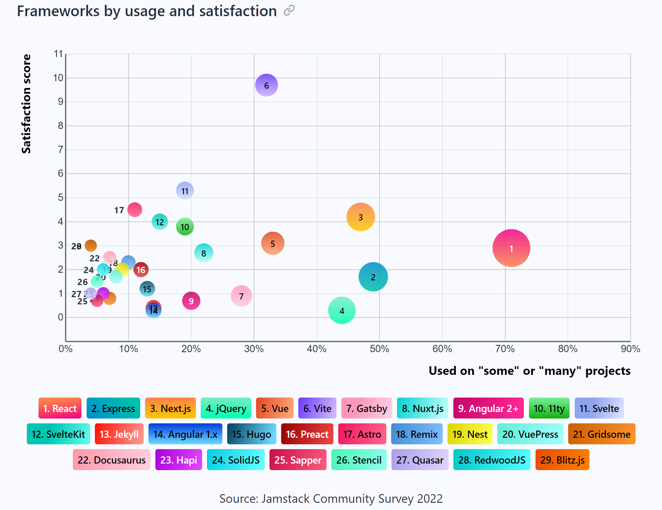
Jamstack Community Survey 2022
https://jamstack.org/survey/2022/#choices

Slide 9
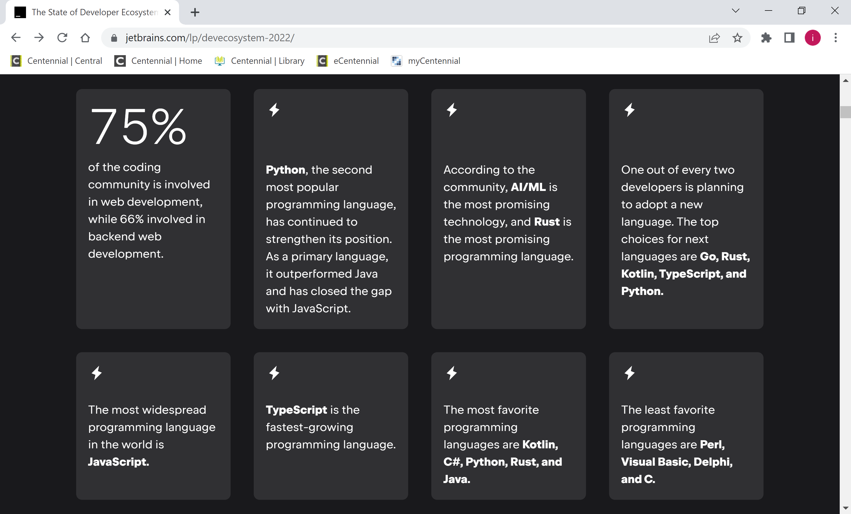
The State of Developer Ecosystem 2022
https://www.jetbrains.com/lp/devecosystem-2022/

Slide 10
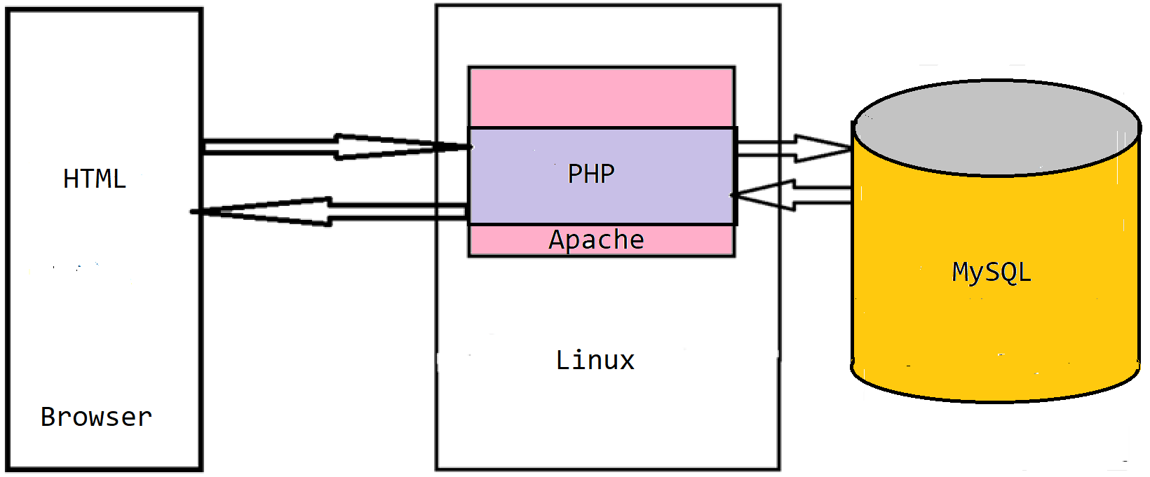
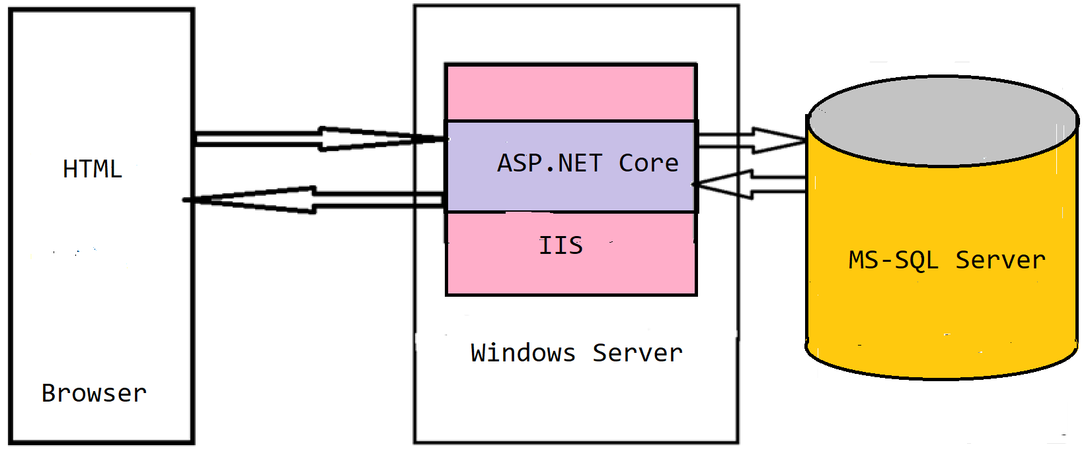
Web Technology Stacks
LAMP stack:
Linux
Apache
MySQL
PHP/Python/Perl
.NET (Core) stack:
.NET (Core)
IIS
ASP.NET (Core)
Web API and WCF
MS-SQL Server
Other frameworks and tools (Django, Flask, etc.)
Each layer uses a different knowledge base!

Slide 11
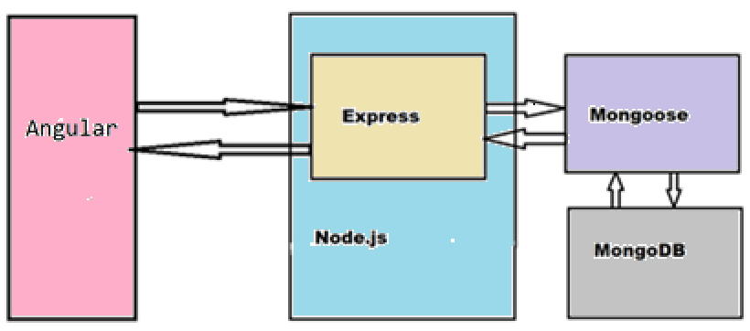
MEAN Stack
MEAN is an abbreviation for MongoDB, Express, AngularJS, and Node.js.
Uses only JavaScript - driven solutions to implement the different parts of a web application.
Has the following advantages:
A single language is used throughout the application
All the parts of the application can support and often enforce the use of the MVC architecture
Serialization and deserialization of data structures is no longer needed because data marshaling is done using JSON objects.

Slide 12
MEAN Stack
MongoDB is a scalable NoSQL database that used a JSON-like data model with dynamic schemas.
Express is a lightweight node.js web application framework, providing a robust set of features for building single and multi-page, and hybrid web application.
Node.js is a server side JavaScript execution environment built on Google Chrome’s V8 JavaScript runtime - helps in building highly scalable and concurrent applications rapidly.
Angular is a JavaScript framework developed by Google - a complete solution for rapid front end development.

Slide 13
LAMP versus MEAN
Linux ➔ Node.js (platform)
Apache ➔ Express.js (web server framework)
MySQL ➔ MongoDB (persistence layer)
PHP or Python or Perl ➔ Angular (User Interface)

Slide 14
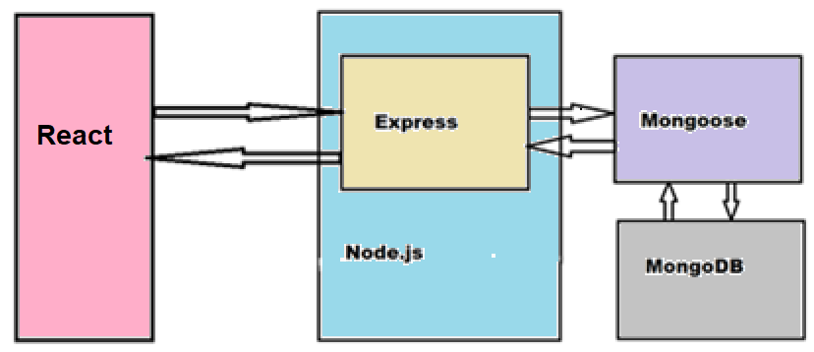
MERN Stack
MongoDB
Express
Node.js
ReactJS is a JavaScript component-based front-end library maintained by Facebook – most popular for front-end development.

Slide 15
MEAN and MERN Advantages
High Performance
Increasing number of requests
Reducing response time
Non-blocking I/O - allows web server to handle more concurrent requests without requiring additional hardware or configuration
Cross-platform (Windows, Linux, MacOS)
One single programming language for the entire project

Slide 16
The Evolution of JavaScript
The standard for JavaScript is ECMAScript.
On June 17, 2015, ECMA International published the sixth major version of ECMAScript, which is officially called ECMAScript 2015, and is more commonly referred to as ECMAScript 6 or ES6.
Since then ECMAScript standards are on yearly release cycles.
Here is the ES6 guide:
https://leanpub.com/ecmascript2015es6guide/read
Current versions of Chrome, Firefox, Edge, Safari, and Opera support ES6 features.
ECMAScript 2021 (https://262.ecma-international.org/12.0/) is the current version.
https://developer.mozilla.org/en-US/docs/Web/JavaScript

Slide 17
ES6 - Modules
Modules
export – to expose the module
import – to make the module available to use
Example: suppose you have a file named lib.js that contains the following code:
export function halfOf(x) {
return x / 2;
}
In your main.js file, you can use the following code:
import halfOf from 'lib';
console.log(halfOf(84));

Slide 18
ES6 - Modules
Exporting multiple functions:
If lib.js file looks like this:
export function halfOf(x) {
return x / 2;
}
export function multiply(x, y) {
return x * y;
}
In your main.js file, use the following code:
import {halfOf, multiply} from 'lib';
console.log(halfOf(84));
console.log(multiply(21, 2));

Slide 19
ES6 - Modules
Named export are used to export multiple things from a module by adding the keyword export to their declaration.
There can be multiple named exports in a module and they are imported using the name that were used to export.
Default export allows only a single default export per module and we can assign it any name when importing it from another module or file.
Example: doSomething.js that contains the following code:
export default function () {
console.log('I did something')
};
You'll be able to use it as follows in your main.js file:
import doSomething from 'doSomething';
doSomething();
However, is not possible to use var, let or const with export default

Slide 20
ES6 - Modules
Modules export bindings - live connections to values, not just values.
Example: a validator.js file that looks like this:
export let flag = false;
export function touch() {
flag = true;
}
You also have a main.js file that looks like this:
import { flag, touch } from 'validator';
console.log(flag);
touch();
console.log(flag);
The first output would be false, and the second would be true because is modified in function touch.

Slide 21
Let and Const
Let and Const are new keywords used for symbol declaration.
Let statement declares a block scope local variable.
Here is an example:
function iterateVar() {
for(var i = 0; i < 10; i++) {
console.log(i);
}
console.log(i) //will print i
}
function iterateLet() {
for(let i = 0; i < 10; i++) {
console.log(i);
}
console.log(i) //will throw an error
}

Slide 22
Let and Const
The first function will print i after the loop, but the second one will throw an error, since i is defined by let, therefore not defined outside the block.
The const keyword forces single assignment.
So, this code will throw an error as well:
const me = 1
me = 2 //cannot reinitialize

Slide 23
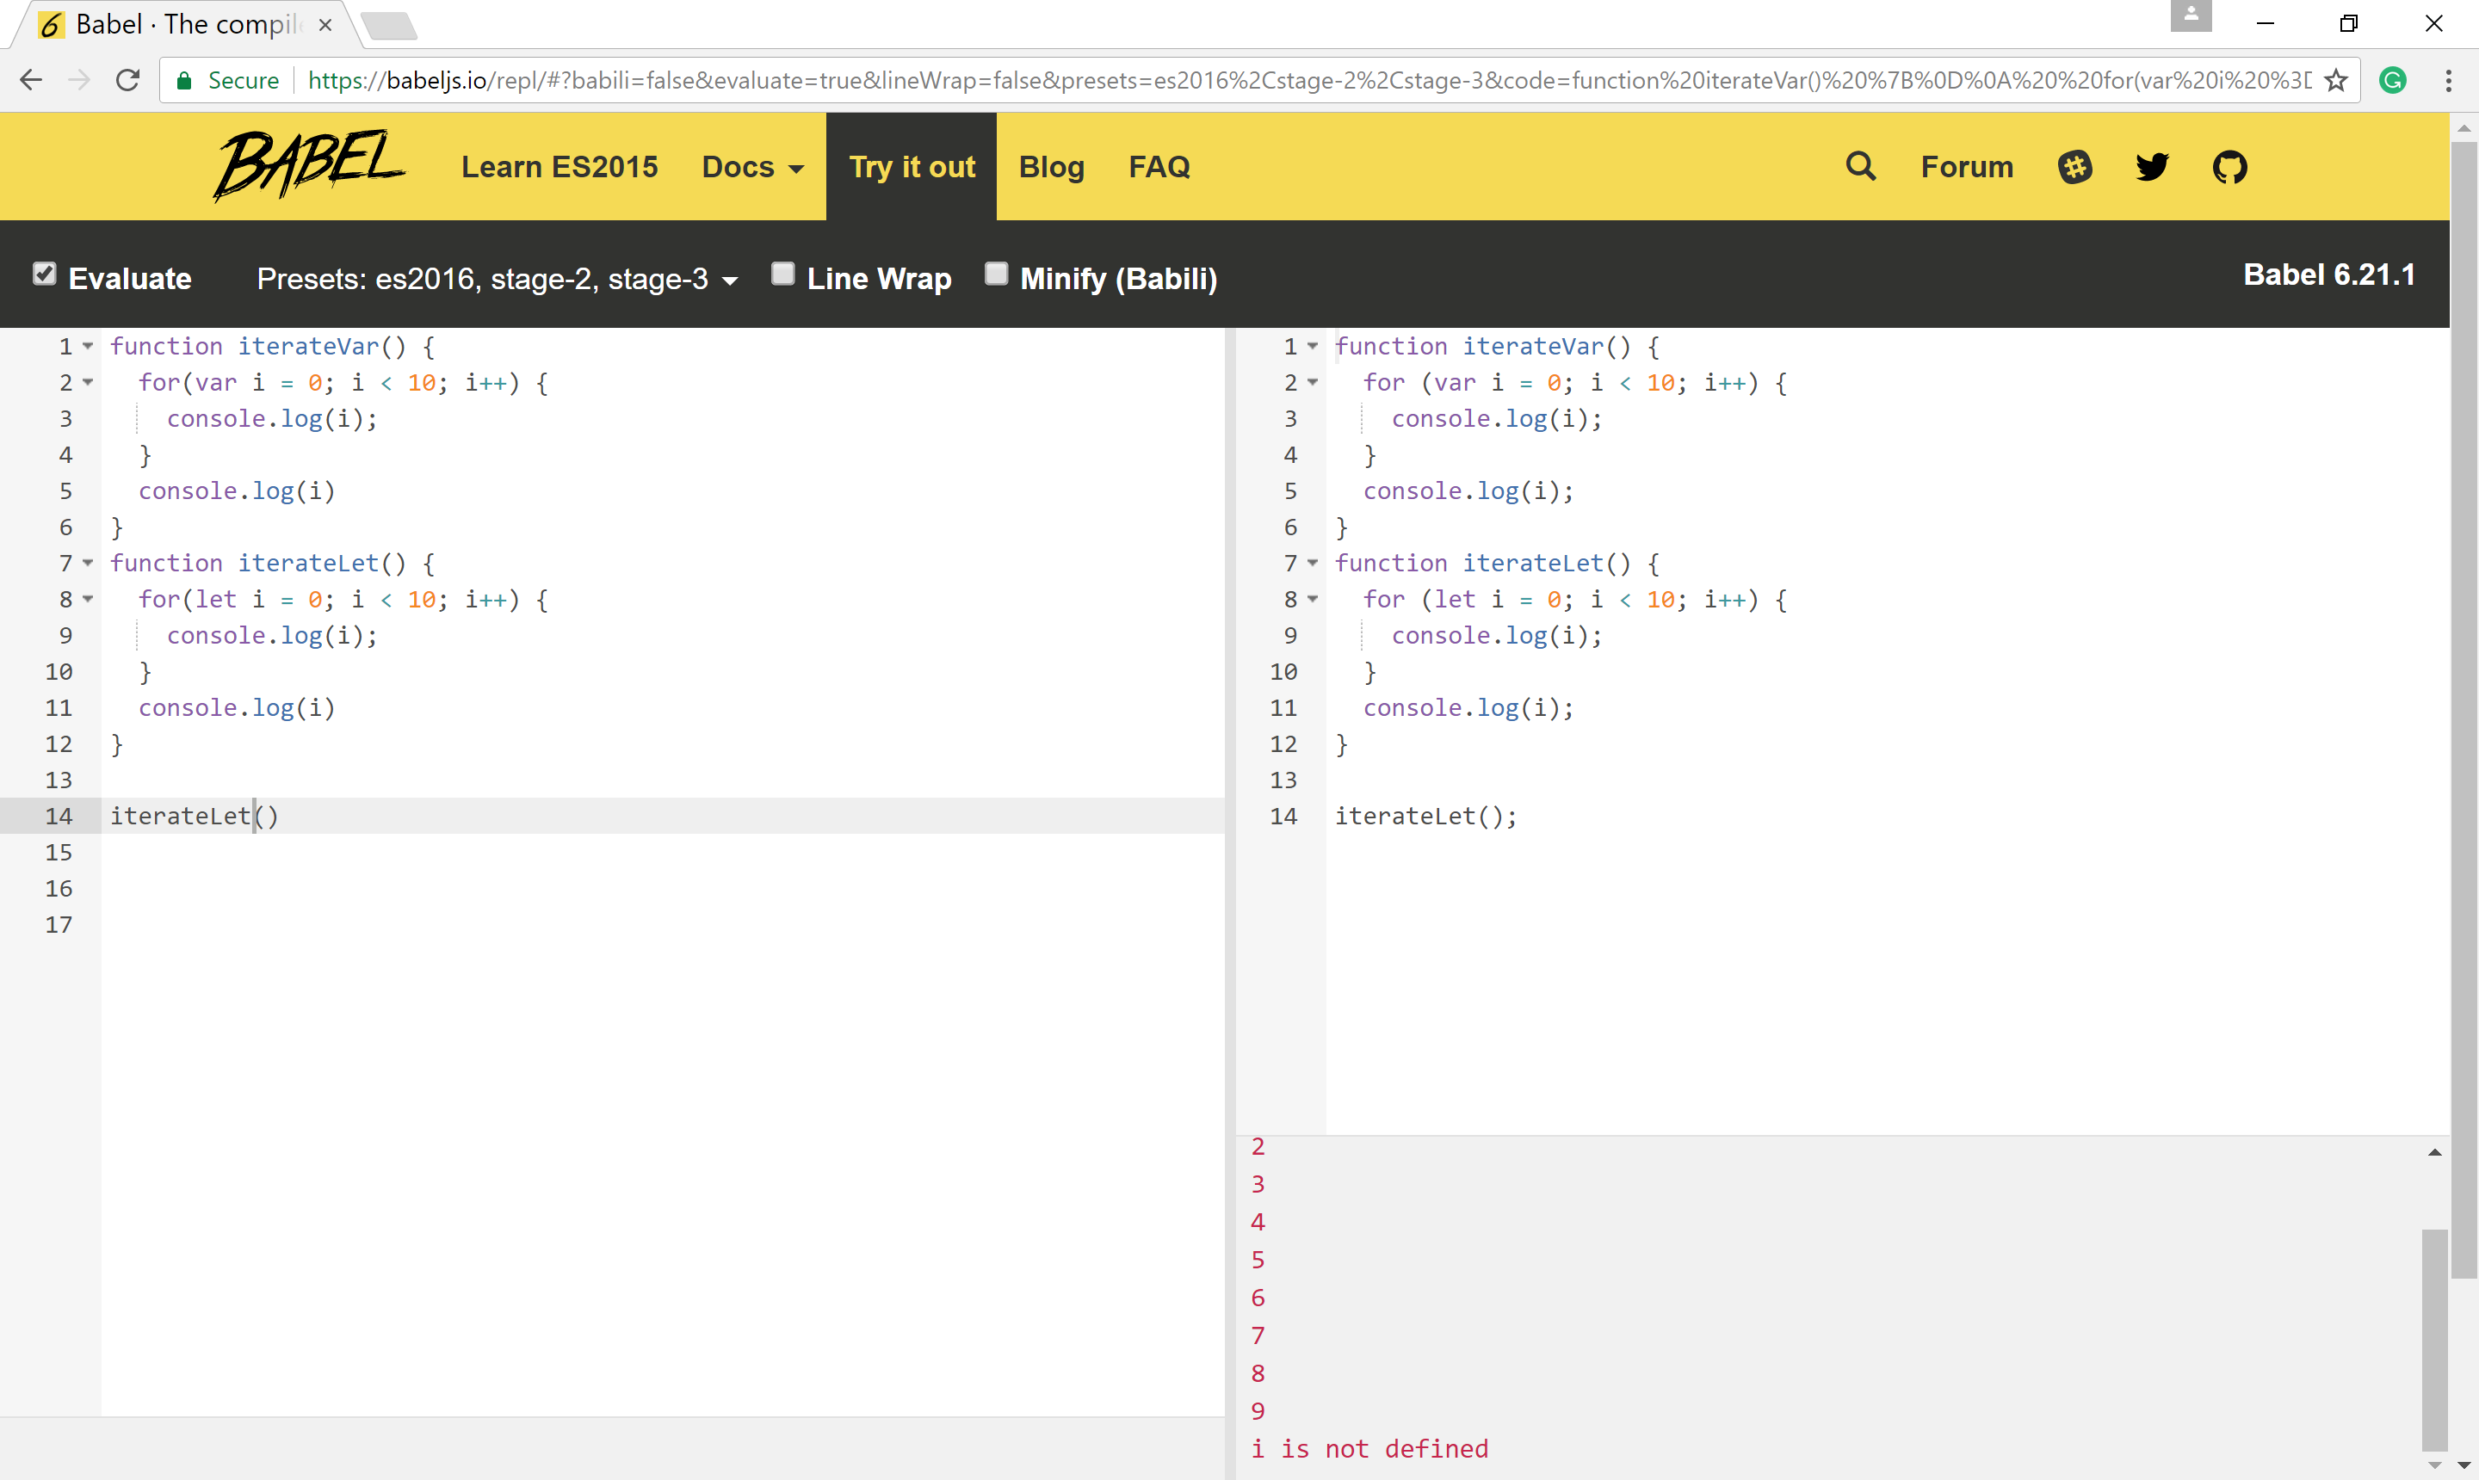
Trying Out ES6
Use jsfiddle (https://jsfiddle.net/) or Babeljs:

Slide 24
ES6 - Classes
Classes in ES6 are basically just a syntactic sugar over the prototype-based inheritance.
class Vehicle {
constructor(wheels) {
this.wheels = wheels;
}
toString() {
return '(' + this.wheels + ')';
}
}
class Car extends Vehicle {
constructor(color) {
super(4);
this.color = color;
}
toString() {
return super.toString() + ' colored: ' + this.color;
}
}

Slide 25
ES6 - Classes
let car = new Car('blue');
car.toString();
console.log(car instanceof Car);
console.log(car instanceof Vehicle);
In this example, the Car class extends the Vehicle class.
The output is as follows:
(4) in blue
true
true

Slide 26
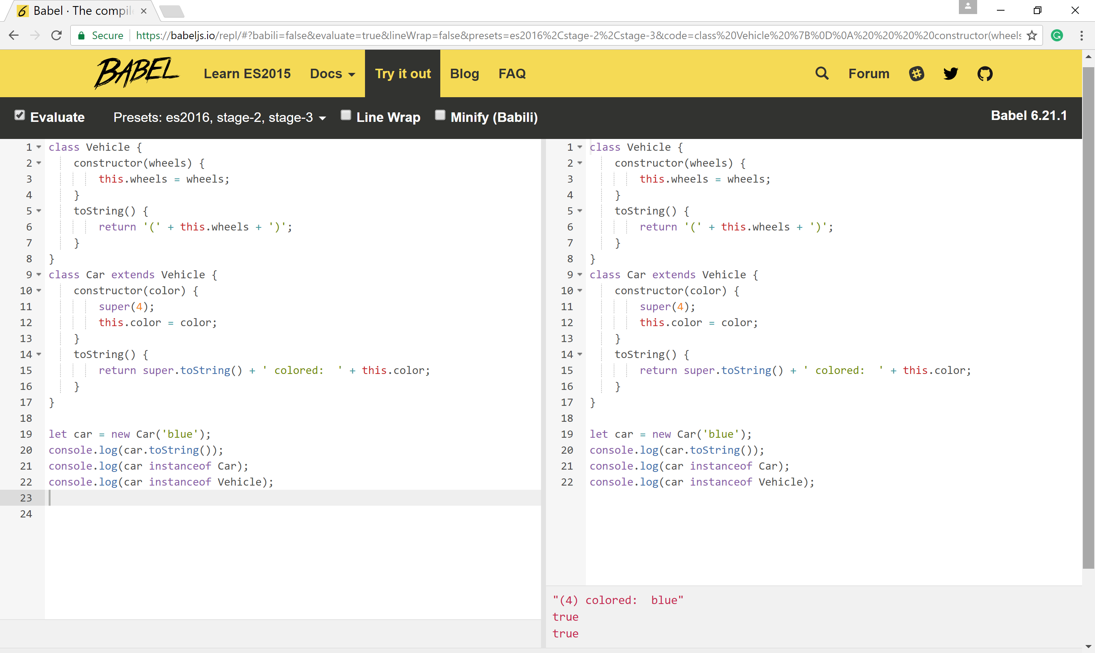
Class Example on Babel
a

Slide 27
Class Example in Browser
<div id="output"></div>
<!-- Load Babel -->
<script src="https://unpkg.com/babel-standalone@6/babel.min.js"></script>
<!-- Your custom script here -->
<script type="text/babel" data-presets="es2016,es2017,stage-2, stage-3">
class Vehicle {
constructor(wheels) {
this.wheels = wheels;
}
toString() {
return '(' + this.wheels + ')';
}
}
class Car extends Vehicle {
constructor(color) {
super(4);
this.color = color;
}
toString() {
return super.toString() + ' colored: ' + this.color;
}
}
let car = new Car('blue');
document.getElementById('output').innerHTML = car.toString() + "<br>";;
document.getElementById('output').innerHTML += (car instanceof Car) + "<br>";
document.getElementById('output').innerHTML += (car instanceof Vehicle);
</script>

Slide 28
Class Example on https://jsfiddle.net/
<div id="output"></div>
<script >
class Vehicle {
constructor(wheels) {
this.wheels = wheels;
}
toString() {
return '(' + this.wheels + ')';
}
}
class Car extends Vehicle {
constructor(color) {
super(4);
this.color = color;
}
toString() {
return super.toString() + ' colored: ' + this.color;
}
}
let car = new Car('red');
document.getElementById('output').innerHTML = car.toString() + "<br>";;
document.getElementById('output').innerHTML += (car instanceof Car) + "<br>";
document.getElementById('output').innerHTML += (car instanceof Vehicle); </script>

Slide 29
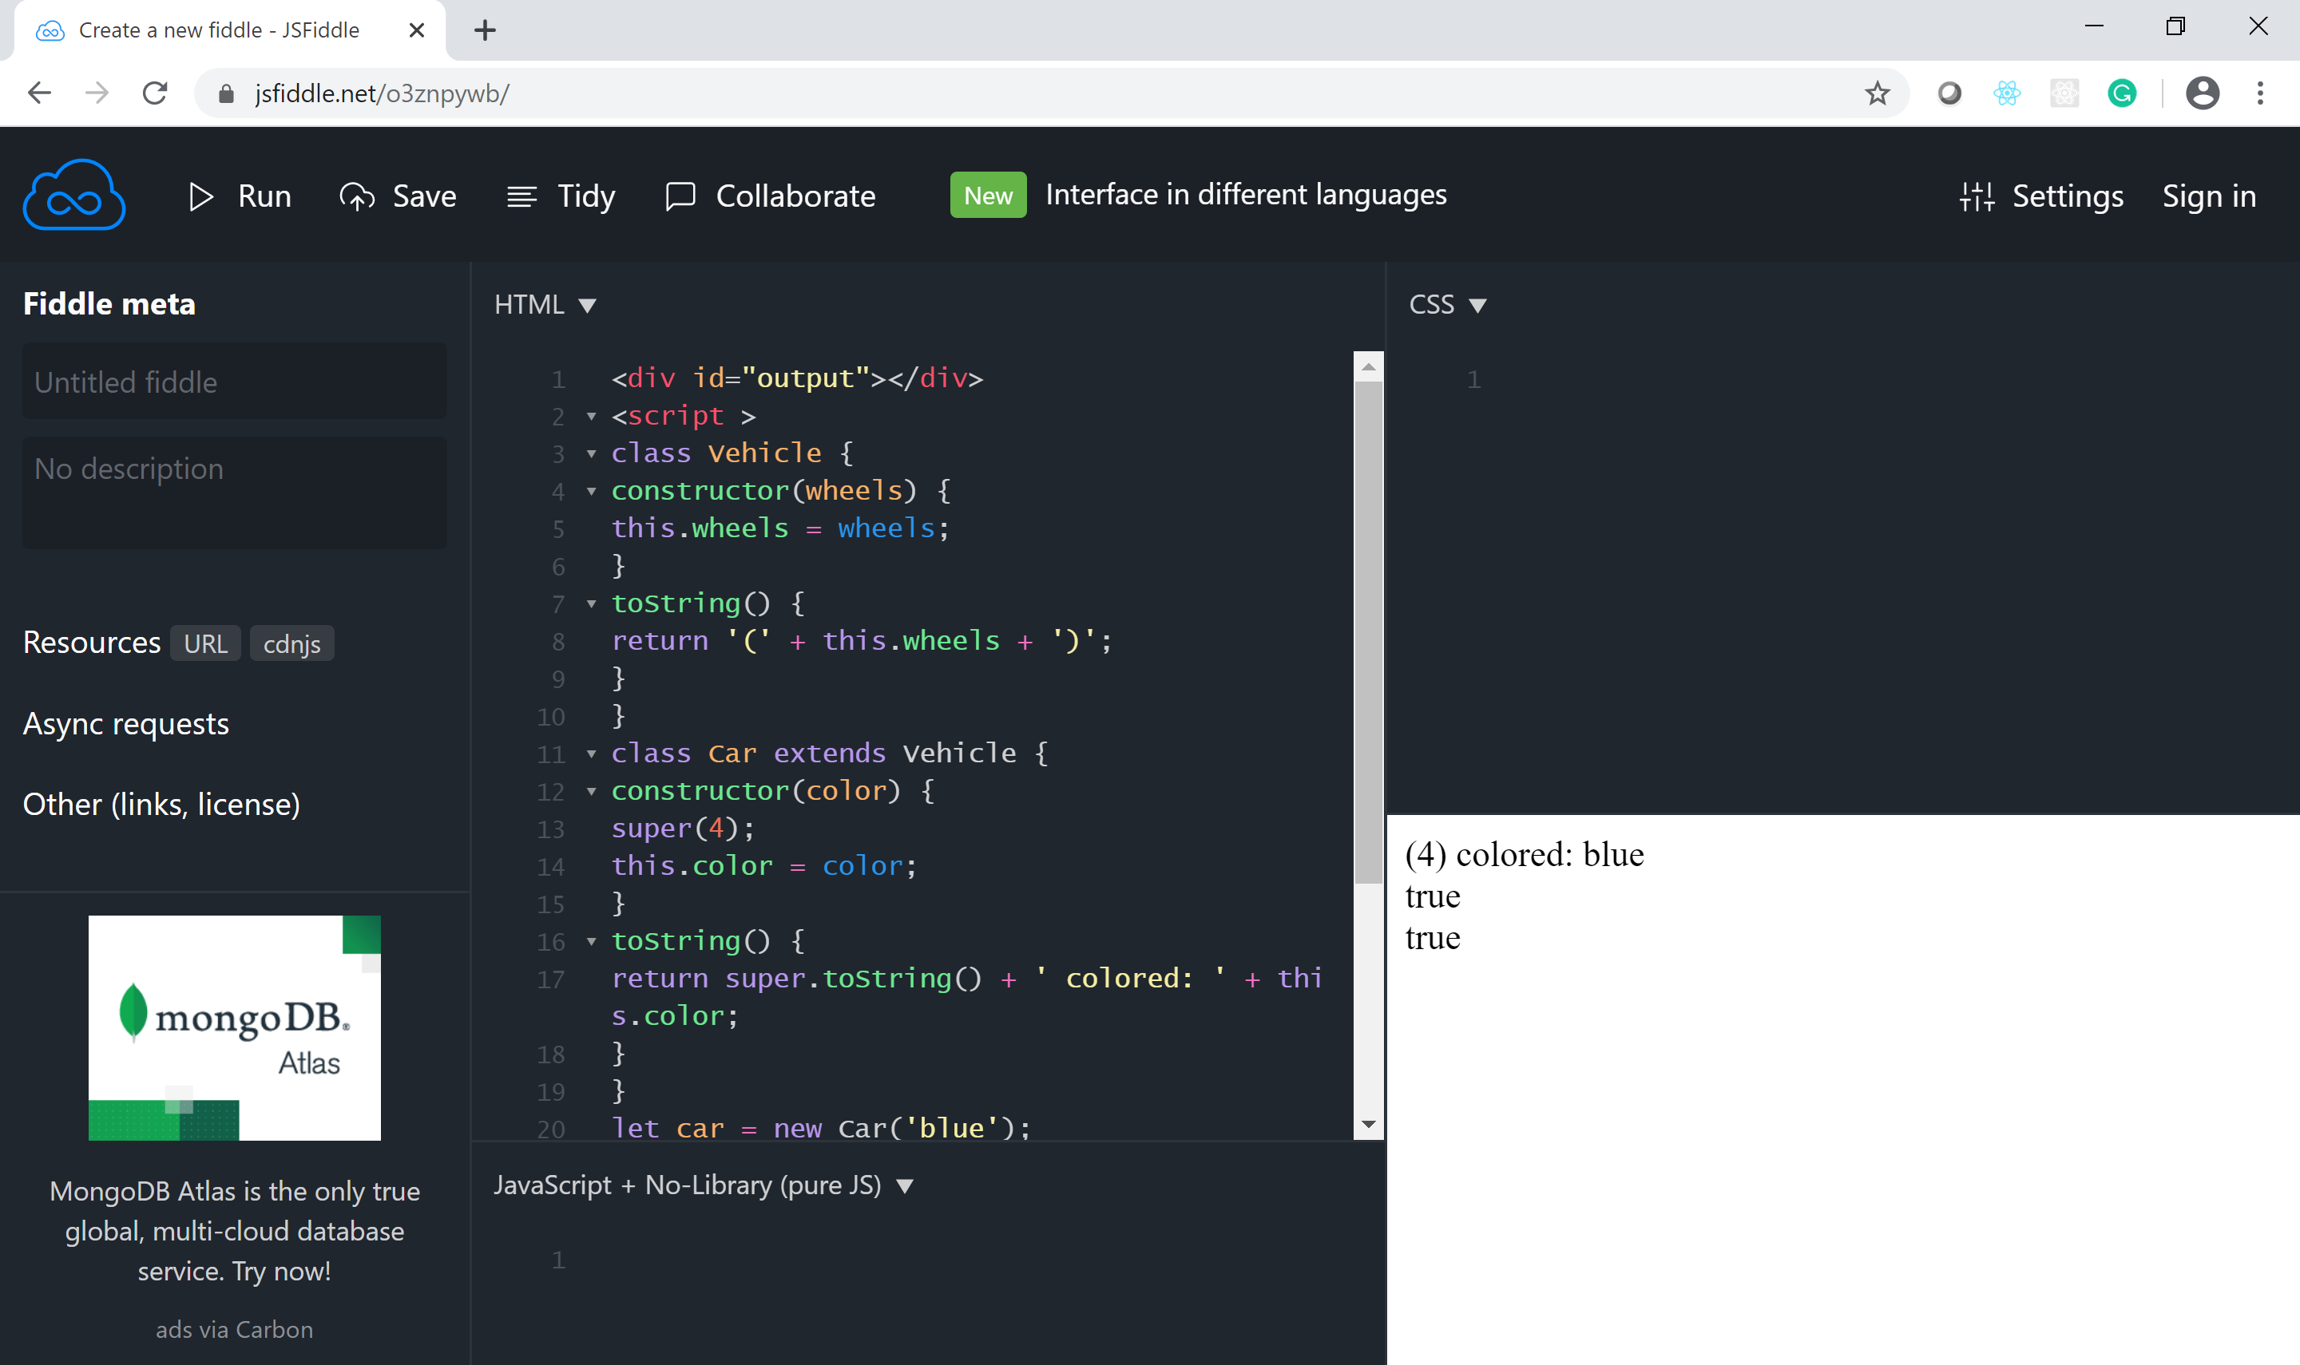
Class Example on https://jsfiddle.net/

Slide 30
Arrow functions
Arrows are functions shorthand by the => syntax.
Used in Java and C#.
Arrows are also very helpful because they share the same lexical this as their scope.
They are mainly used in two forms:
using an expression body:
let numbers = [1,2,3,4,5]
const squares = numbers.map(n => n * n);
console.log('squares:',squares)
using a statement body:
let evens = []
numbers.forEach(n => { //anonymous function code
if (n % 2 === 0) evens.push(n);
});
console.log('even numbers', evens)

Slide 31
Arrow Functions and scope
Lexical scoping means whatever variables are in scope where you define a function from (as opposed to when you call it) are in scope in the function
An example of using the shared lexical would be:
const author = {
fullName: "Bob Alice",
books: [],
printBooks() {
this.books.forEach(book => console.log(book + ' by ' + this.fullName));
}
};
author.books = ["JavaScript", "Python", "Kotlin"]
author.printBooks()
If used as a regular function, this would be the book object and not the author.

Slide 32
Default, Rest, and Spread
Default, Rest, and Spread are three new features related to functions parameters.
The default feature allows you to set a default value to the function parameter:
function add(x, y = 0) {
return x + y;
}
add(1)
add(1,2)
In this example, the value of y will be set to 0 if a value is not passed or is set to undefined.

Slide 33
Rest Operator
The Rest feature allows allows a function to accept an indefinite number of arguments as an array:
function userFriends(user, ...friends) {
console.log(user + ' has ' + friends.length + ' friends');
}
userFriends('User', 'Bob', 'Alice');
This will output:
User has 2 friends
Only the last parameter in a function definition can be a rest parameter.

Slide 34
Spread Operator
The spread operator is three dots (...) that perform several different tasks.
The spread operator turns an array into a call argument:
function userTopFriends(firstFriend, secondFriend, thirdFriend) {
console.log(firstFriend);
console.log(secondFriend);
console.log(thirdFriend);
}
userTopFriends(...['Alice', 'Bob', 'Michelle']);
This will output:
Alice
Bob
Michelle

Slide 35
Spread Operator
We can also use the three dot syntax to collect function arguments as an array.
When used in a function, these are called rest parameters.
Here, we build a function that takes in n number of arguments using the spread operator, and then uses those arguments to print some console messages:
function directions(...args) {
let [start, ...remaining] = args;
let [finish, ...stops] = remaining.reverse();
//
console.log(`drive through ${args.length} towns`);
console.log(`start in ${start}`);
console.log(`the destination is ${finish}`);
console.log(`stopping ${stops.length} times in between`);
}
directions("Truckee", "Tahoe City", "Sunnyside", "Homewood", "Tahoma");
Learning React, 2nd Edition, O’Reilly

Slide 36
Spread Operator
The directions function takes in the arguments using the spread operator.
The first argument is assigned to the start variable.
The last argument is assigned to a finish variable using Array.reverse.
We then use the length of the arguments array to display how many towns we’re going through.
The number of stops is the length of the arguments array minus the finish stop.
This provides incredible flexibility because we could use the directions function to handle any number of stops.
Learning React, 2nd Edition, O’Reilly

Slide 37
Spread Operator
Allows us to combine the contents of arrays.
For example, if we had two arrays, we could make a third array that combines the two arrays into one:
const peaks = ["Tallac", "Ralston", "Rose"];
const canyons = ["Ward", "Blackwood"];
const tahoe = [...peaks, ...canyons];
console.log(tahoe.join(", ")); // Tallac, Ralston, Rose, Ward, Blackwood
All of the items from peaks and canyons are pushed into a new array called tahoe.
The spread operator can also be used to get the remaining items in the array:
const lakes = ["Donner", "Marlette", "Fallen Leaf", "Cascade"];
const [first, ...others] = lakes;
console.log(others.join(", ")); // Marlette, Fallen Leaf, Cascade
Learning React, 2nd Edition, O’Reilly

Slide 38
Spread Operator
The spread operator can also be used for objects.
In this example, we’ll use it the same way we combined two arrays into a third array, but instead of arrays, we’ll use objects:
const morning = {
breakfast: "oatmeal",
lunch: "peanut butter and jelly"
};
const dinner = "mac and cheese";
const backpackingMeals = {
...morning,
dinner
};
console.log(backpackingMeals);
// {
// breakfast: "oatmeal",
// lunch: "peanut butter and jelly",
// dinner: "mac and cheese"
// }
Learning React, 2nd Edition, O’Reilly

Slide 39
Function Expressions
Another option is to use a function expression.
This just involves creating the function as a variable:
const logCompliment = function() {
console.log("You're doing great!");
};
logCompliment();
Note that:
you can invoke a function before you write a function declaration.
you can not invoke a function created by a function expression before declaring it.
Learning React, 2nd Edition, O’Reilly

Slide 40
Returning Objects
Consider a function called person that builds an object based on parameters passed in for firstName and lastName.
Wrap the object you’re returning with parentheses:
const person = (firstName, lastName) => ({
first: firstName,
last: lastName
});
console.log(person("Flad", "Hanson"));
Learning React, 2nd Edition, O’Reilly

Slide 41
Destructuring Objects
Destructuring assignment allows you to locally scope fields within an object and to declare which values will be used.
Consider the sandwich object:
const sandwich = {
bread: "dutch crunch",
meat: "tuna",
cheese: "swiss",
toppings: ["lettuce", "tomato", "mustard"]
};
It has four keys, but we only want to use the values of two.
We can scope bread and meat to be used locally:
const { bread, meat } = sandwich;
console.log(bread, meat); // dutch crunch tuna
Learning React, 2nd Edition, O’Reilly

Slide 42
Destructuring Function Arguments
const lordify = ({ firstname }) => {
console.log(`${firstname} of Canterbury`);
};
const regularPerson = {
firstname: "Bill",
lastname: "Wilson"
};
lordify(regularPerson); // Bill of Canterbury
Learning React, 2nd Edition, O’Reilly

Slide 43
Destructuring Arrays
Assign the first value of an array to a variable name:
const [firstAnimal] = ["Horse", "Mouse", "Cat"];
console.log(firstAnimal); // Horse
We can also pass over unnecessary values with list matching using commas:
const [, , thirdAnimal] = ["Horse", "Mouse", "Cat"];
console.log(thirdAnimal); // Cat
Learning React, 2nd Edition, O’Reilly

Slide 44
Object Literal Enhancement
It’s the opposite of destructuring
We can grab variables from the global scope and add them to an object:
const name = "Tallac";
const elevation = 9738;
const funHike = { name, elevation };
console.log(funHike); // {name: "Tallac", elevation: 9738}
name and elevation are now keys of the funHike object.
Learning React, 2nd Edition, O’Reilly

Slide 45
Object Literal Enhancement
We can also create object methods with object literal enhancement:
const skier = {
name,
sound,
powderYell() {
let yell = this.sound.toUpperCase();
console.log(`${yell} ${yell} ${yell}!!!`);
},
speed(mph) {
this.speed = mph;
console.log("speed:", mph);
}
};
Object literal enhancement allows us to pull global variables into objects and reduces typing by making the function keyword unnecessary.
Learning React, 2nd Edition, O’Reilly

Slide 46
Asynchronous JavaScript
JavaScript functions are executed in the sequence they are called, not in the sequence they are defined.
To handle asynchronous calls JavaScript uses:
Callbacks
Promises
async/await statements
A callback is a function passed as an argument to another function.
See the example in the next slide.

Slide 47
Asynchronous JavaScript - Callbacks
<!DOCTYPE html>
<html>
<body>
<h2>JavaScript Callback</h2>
<p>Wait 3 seconds (3000 milliseconds) for this page to change.</p>
<h1 id="demo"></h1>
<script>
setTimeout(myFunction, 3000);
function myFunction() {
document.getElementById("demo").innerHTML = "callback executed !!";
}
</script>
</body>
</html>
https://www.w3schools.com/js/js_callback.asp

Slide 48
Asynchronous JavaScript - Promises
Promises are used to handle asynchronous operations in JavaScript.
A promise can be created using Promise constructor. syntax:
var promise = new Promise(function(resolve, reject){
//do something
});
var promise = new Promise(function(resolve, reject) {
const x = "geeksforgeeks";
const y = "geeksforgeeks"
if(x === y) {
resolve();
} else {
reject();
}
});
promise.
then(function () {
console.log('Success, You are a GEEK');
}).
catch(function () {
console.log('Some error has occured');
});
https://www.geeksforgeeks.org/javascript-promises/

Slide 49
Asynchronous JavaScript - Promises
The promise is an object that represents whether the async operation is pending, has been completed, or has failed.
The then method will invoke the callback function once the promise has resolved.
Here is an example using fetch method to fetch resources asynchronously across the network.
A basic fetch call takes a url and returns a promise containing the response:
fetch("https://api.randomuser.me/?nat=US&results=1").then(res => console.log(res.json()));
Whatever you return from this function becomes the argument of the next then function.
fetch("https://api.randomuser.me/?nat=US&results=1")
.then(res => res.json())
.then(json => json.results)
.then(console.log)
.catch(console.error);
Learning React, 2nd Edition, O’Reilly

Slide 50
Async/Await
The async and await keywords enable asynchronous, promise-based behavior to be written in a cleaner style, avoiding the need to explicitly configure promise chains.
const getFakePerson = async () => {
try {
let res = await fetch("https://api.randomuser.me/?nat=US&results=1");
let { results } = res.json();
console.log(results);
} catch (error) {
console.error(error);
}
};
getFakePerson();
Learning React, 2nd Edition, O’Reilly

Slide 51
Async/Await
async makes a function return a Promise
await makes a function wait for a Promise
async keyword is placed in front of a function declaration to turn it into an async function.
const getFakePerson = async () => { }
Then await keyword is used inside the function:
let res = await fetch("https://api.randomuser.me/?nat=US&results=1");
Multiple await statements are allowed.
Use try/catch for exception handling.

Slide 52
References
Reference Textbooks
https://leanpub.com/ecmascript2015es6guide/read
https://developer.mozilla.org/en-US/docs/Web/JavaScript/Reference/Statements/export
https://developer.mozilla.org/en-US/docs/Web/JavaScript/Reference/Statements/import
http://www.2ality.com/2015/08/getting-started-es6.html
https://leanpub.com/setting-up-es6/read
http://exploringjs.com/es2016-es2017/index.html
http://es6-features.org/
https://tsh.io/state-of-microservices/?utm_source=event&utm_medium=social&utm_campaign=soms_report&utm_content=webinar_backend#ebook
https://techbeacon.com/app-dev-testing/top-5-software-architecture-patterns-how-make-right-choice
https://martinfowler.com/articles/micro-frontends.html#InANutshell
Learning React, 2nd Edition, O’Reilly
State-of-Frontend-2022-by-TSH
https://www.htmlgoodies.com/beyond/javascript/the-model-view-viewmodel-pattern-and-angular-development.html
https://www.angularminds.com/blog/article/mvc-vs-mvp-mvvm.html
https://jamstack.org/survey/2021/#choices
https://www.jetbrains.com/lp/devecosystem-2022/

